Slide 1
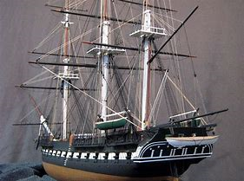
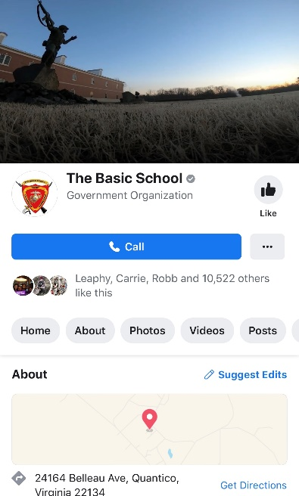
THE BASIC SCHOOL
CAMP BARRETT BULLETIN
Issue No. 4 | September 2019 | Published: 6 September 2019 | Page 1 of 2
Monthly Focus:
Senior Leaders’ Conference (SLC) | IEP 300, 100, 75, 50 Graduations| Co. G, 7-19 receiving | IOC Graduation
Ship Building at The Basic School,
a Paradigm for Developing Leaders
By: Col David R. Everly, Commanding Officer
The recently released Commandant’s Planning Guidance directs the Corps to focus on naval integration. In that vein, The Basic School remains poised to resource this guidance through ‘ship building’! Not literal ship building akin to the ship yards that power maritime industry across the globe, but ship building as a mental model for developing the leaders of tomorrow. The Basic School forges leaders through an experience not replicated anywhere else in the service. Put simply, we build model ships…
Mentorship. The cadre consist of over 150 officers (permanent personnel). This enables TBS faculty to mentor student personnel facing a wide variety of issues in an effort to maximize the number of first attempt graduates going through entry level officer training. Student officers get exposed to a variety of mentorship styles throughout the program of instruction ranging from one-on-one to the small group level; both formal and informal.
Stewardship. Effective leadership of Marines and Sailors requires expert management of resources (personnel, materiel, facilities, and time). This stewardship of resources begins at TBS. Student officers learn to maximize the resources entrusted to them in order to sustain the highest level of readiness possible.
Relationships. Many of the relationships developed at TBS endure for the entirety of officer’s career. In some instances, a lifetime. This becomes evident on Camp Barrett each year as reunion groups return to TBS to reflect on the impact of the BOC/WOBC experience on their careers and lives. Each member of the faculty understands the significance of this ‘ship’ on the overall fleet and works to foster and preserve positive relationships
Scholarship. Each year we marvel at the caliber of scholars matriculating through The Basic School. Each training company consists of men and women with demonstrated academic excellence; individuals sought after by captains of industry who ultimately made the decision to serve. TBS faculty must remain cognizant of this reality and ensure TBS sets the trajectory for sustained scholarship amongst newly commissioned and appointed officers.
Dedication, Patience, Skill, all required elements for developing a leader.
Officership. The lifelong journey of serving as a Marine officer in the Armed Forces begins at TBS. Whether you’re a seasoned prior enlisted Marine or new to the Marine Corps, TBS students begin learning officership here at Camp Barrett. In fact, our students demonstrate tremendous growth as officers; accelerated by the rigors of the Basic Officer Course and Warrant Officer Basic Course programs of instruction.
Leadership. Everything we do at TBS prepares newly commissioned and appointed officers to lead Marines and Sailors in the fleet. Arguably, the flagship of the fleet in this model, leadership will endure as an integral component of the student experience.
@TheBasicSchool

Slide 2
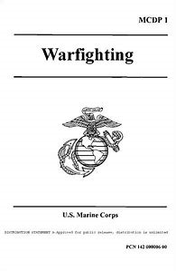
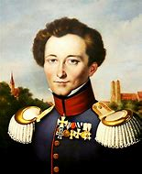
THE BASIC SCHOOL
CAMP BARRETT BULLETIN
Issue No. 4 | September 2019 | Published: 6 September 2019 | Page 2 of 2
Ship Building cont.
Ownership. TBS student and permanent personnel fall shy of perfection each day; however, they are men and women of exemplary character and take ownership for individual and unit shortfalls. Without this ‘ship’, we cannot sustain the requirement of producing leaders uniformly capable and deserving of the challenge/privilege of leading Marines and Sailors.
Hardship. We may not remember all the great days at TBS, but we can all recall with remarkable accuracy the most…demanding experiences in the Quantico highlands. For some companies it’s snow, wind, ice, and sleet during field exercises. For other companies it’s extreme heat advisories during land navigation, tactical movements under load, or live ranges. No matter the experience, the shared hardship forges camaraderie amongst student officers and provides a practical application in human factors rarely emulated in training environments after leaving TBS. You’ll depart Camp Barrett having pushed yourself to the limit and now know that you’re capable of enduring hardship. You will accept nothing less from your Marines and Sailors as their lives may depend on the ability endure hardship.
Sponsorship. TBS, like many units, takes pride in active sponsorship for inbound permanent and student personnel. The TBS experience begins upon notification of orders to serve or train at Camp Barrett. The faculty works to ensure permanent personnel hit the ground ready to train future leaders. At the same time, we dedicate personnel to ensuring each student arrives at TBS poised to achieve their full potential. None of this is possible without sponsorship.
Apprenticeship. “The early stages of a leader’s career are, in effect, an apprenticeship. While receiving a foundation in theory and concepts that will serve them throughout their careers… A Marine’s goal at this stage is to become an expert in the tactical level of war.” MCDP-1, Warfighting
An inherent component of the Basic Officer Course, the course material increases in complexity from individual, to squad, then to platoon, and concludes with an introduction to basic Marine Air Ground Task Force (MAGTF) concepts. As the student officer progresses through the course, the experience resembles that of an apprentice. The faculty ‘pours’ into each student officer until the adult learner reaches an inflection wherein they are ready to explore ways to leverage the knowledge gained at TBS to benefit the Marines and Sailors under their charge. This ‘ship’ best reflects the leadership development philosophy applied at TBS.
The ‘ships’ built every day here at Camp Barrett require each member of the team to commit to brilliance in the basics. In doing so, TBS remains poised to endure as the enterprise cornerstone for basic leadership and ethics training. Further, we sustain the agility to adapt to changes in the operating environment. It seems fitting we adopt a paradigm aligned with our naval traditions as we chart a new course under the ‘stewardship’ of the 38th Commandant of the Marine Corps.
Camp Barrett Chapter Warfighting Society
“The essence of maneuver is taking action to generate and exploit some kind of advantage over the enemy as a means of accomplishing our objectives as effectively as possible” MCDP-1
The Warfighting Society, Camp Barrett chapter, established itself with the express desire of placing students and instructors in a venue to continue to develop and test Warfighting excellence. If you’re interested, seek us out, Thursdays at “The Hawk.”
Get published in the October 2019 edition of the Camp Barrett Bulletin!
Email your submission to Captain Andrew J. Rudd, Current Operations Officer, TBS at: andrew.rudd@usmc.mil
Suspense for inclusion in October 2019 edition: Friday, 27 September 2019

